Slide 1
Genetic Sequencing
Microbiome Time Series Prediction
CS209b Final Project
5/9/2021
Estelle Yao, Ivan Shu and Hillary Tsang

Slide 2
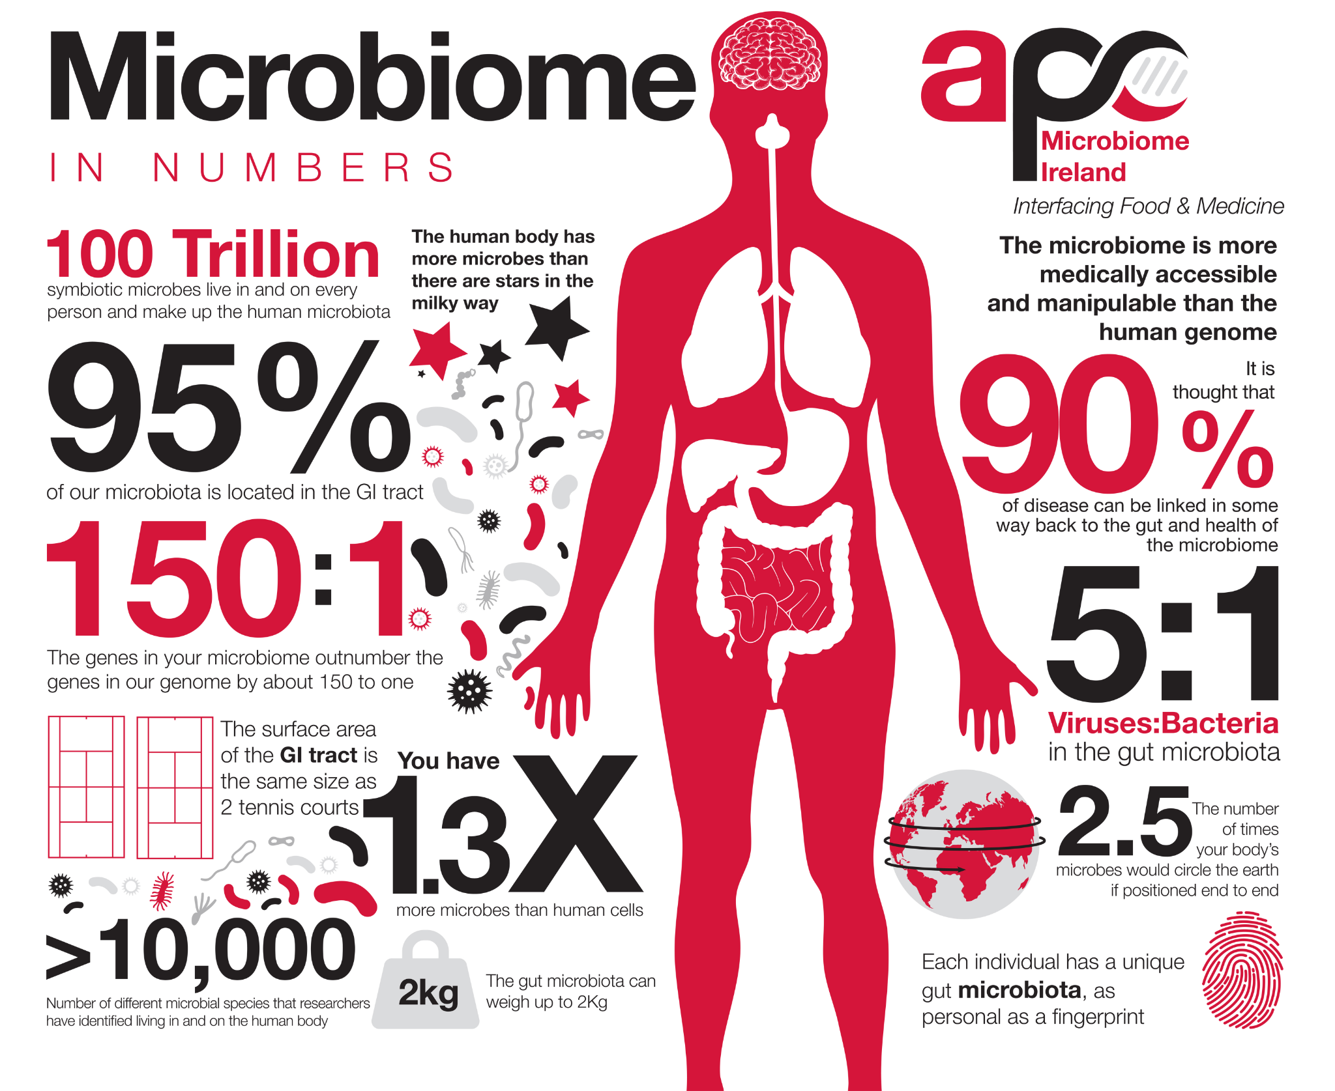
Background
The human microbiome is a dynamic system of microbe-microbe and host-microbe interactions
The microbiome evolves to respond to perturbations like changes in diet or treatment by drugs to affect human health
https://worldmicrobiomeday.com

Slide 3
Project Overview
Multi-tasking GRU-based neural networks to model (1) microbial composition (%) and (2) absolute abundance (CFU/g) at each time point and classify sample origin
in silico experiments to perturb input abundances for prediction and determine
How is change in abundance of one microbial class at a certain treatment interval affect other class compositions and their absolute abundance?
Among all classes present in our model, which microbe change has the largest influence on other classes?
For both questions aforementioned, can we also answer how these are changes similar or different in healthy versus ulcerative colitis groups?

Slide 4
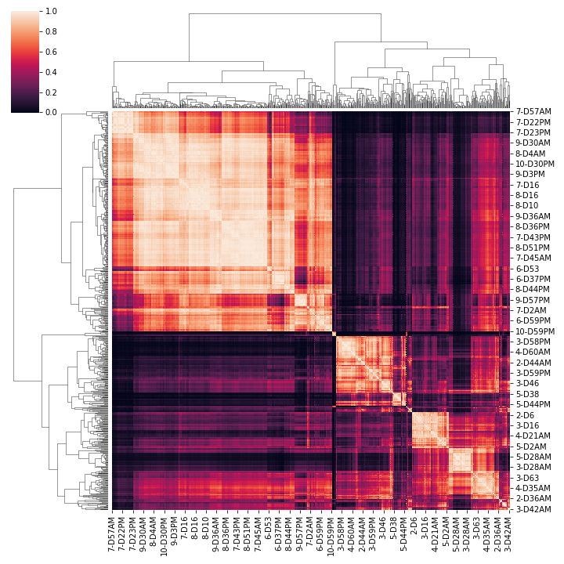
Healthy and Ulcerative Colitis Donors Revealed Distinct Time Series Patterns
Heatmap of pairwise pearson correlation
Each Group tend to cluster together
Heatmap of pairwise pearson correlation
Each donor group tends to cluster together
Ulcerative Colitis Donor
Healthy Donor

Slide 5
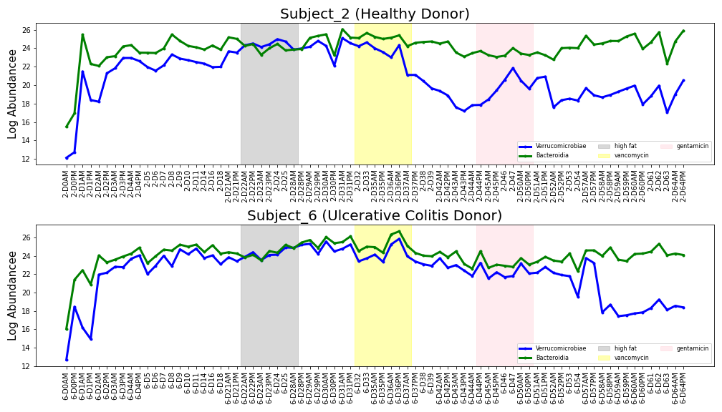
Absolute Abundances for Top Classes Reveals Different Dynamics
Divergent
Divergent

Slide 6
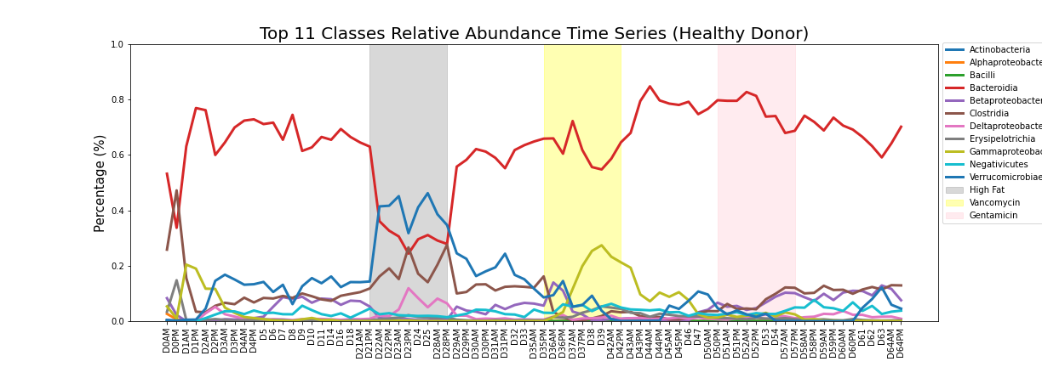
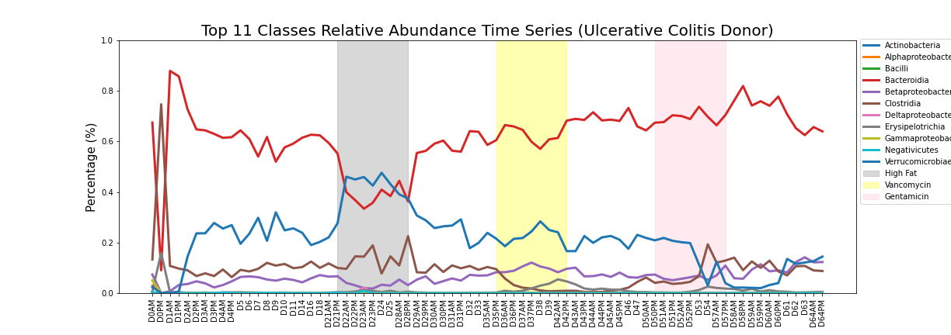
Relative Abundances for Top Classes across Time Points
Healthy donors have more diversity
High fat treatment shows interactions between Bacteroidia and Verrucomicrobiae
Healthy and disease donors show different class compositions at Vencomycin treatment

Slide 7
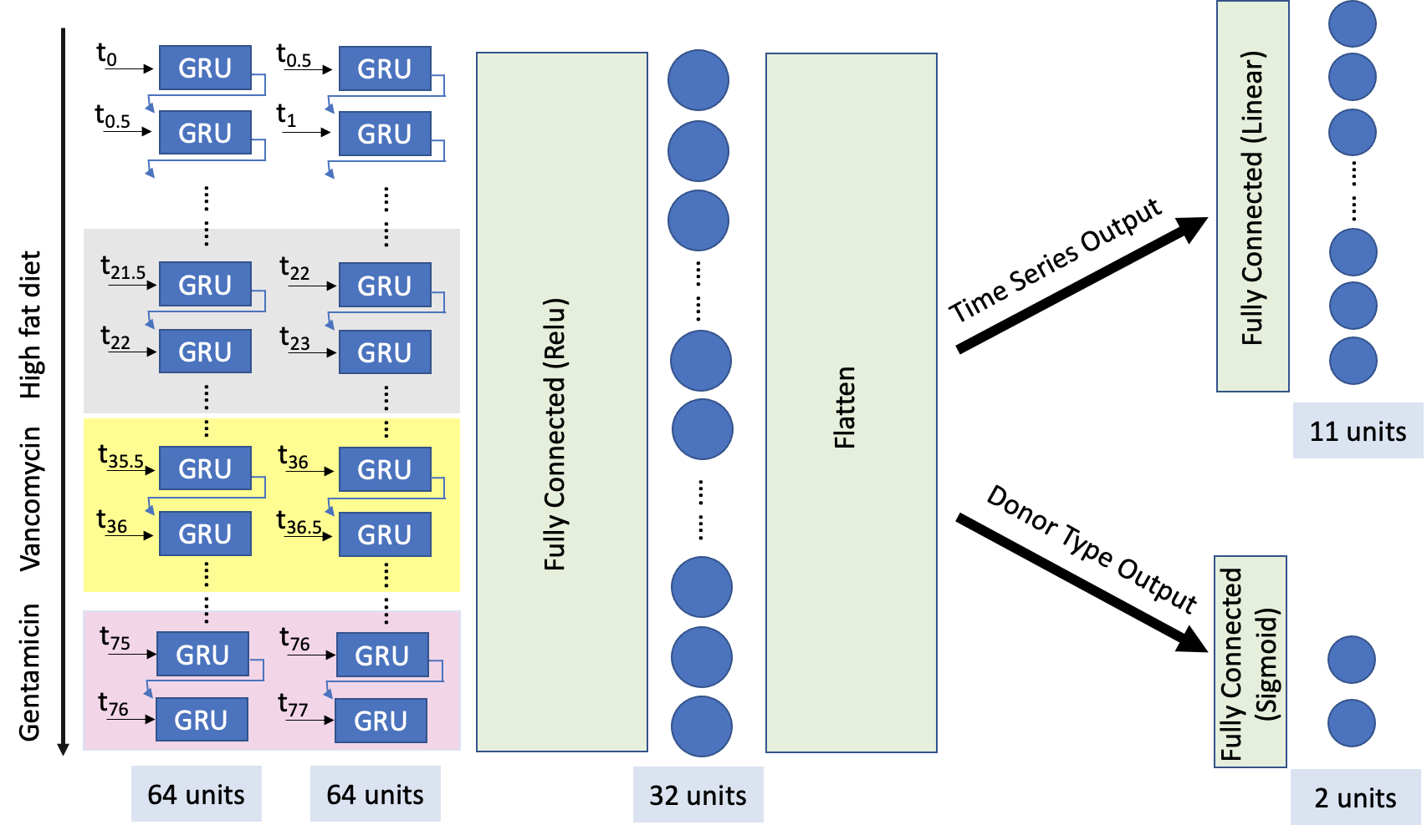
Multi-Head GRU Model Architecture

Slide 8
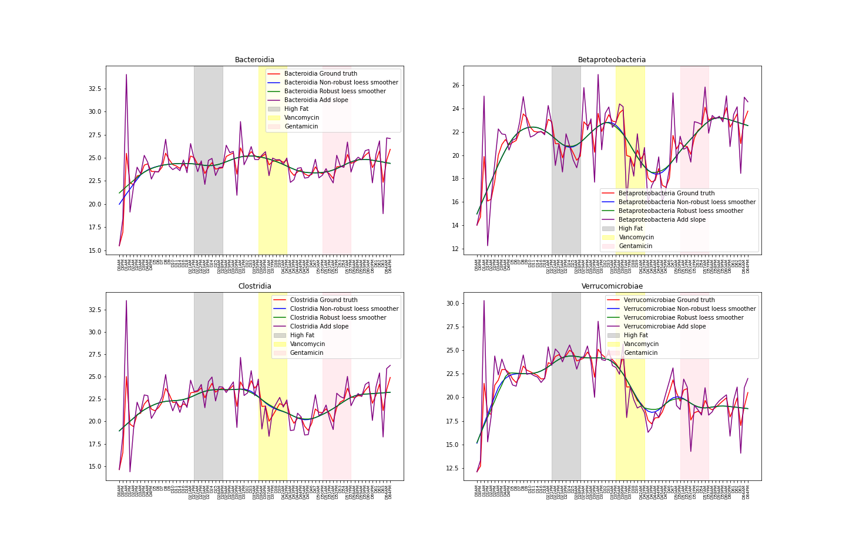
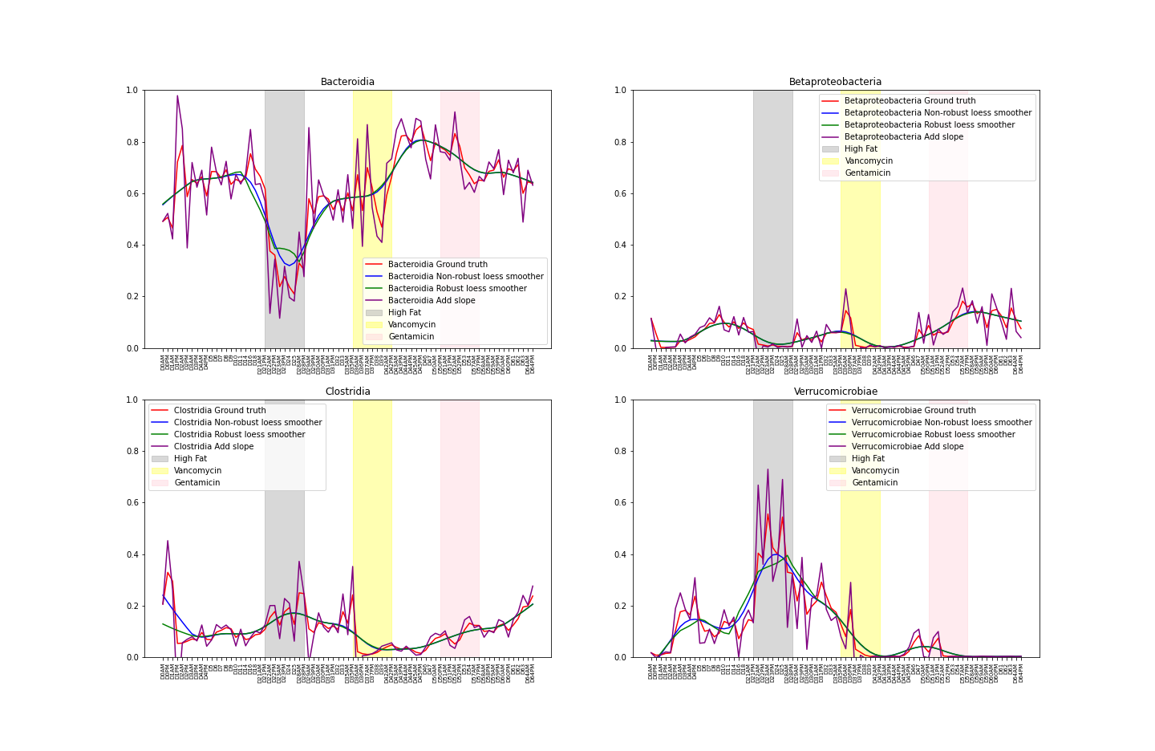
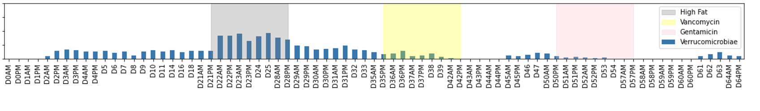
Data augmentation
Absolute abundance
Relative abundance
Robust loess smoothing estimation
Non-robust loess smoothing estimation
Add first moment estimation as a linear trend
Permutate treatment sequences
Assuming each treatment interval is independent
Apply loess and first moment estimation to each permutation

Slide 9
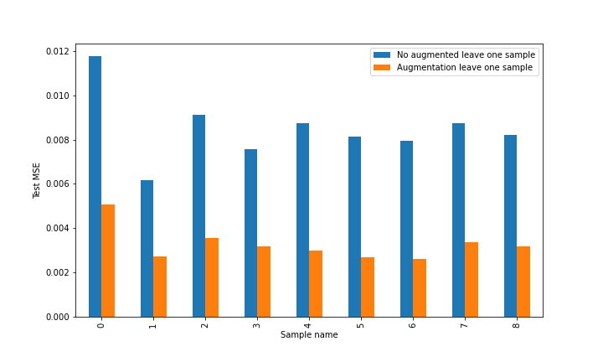
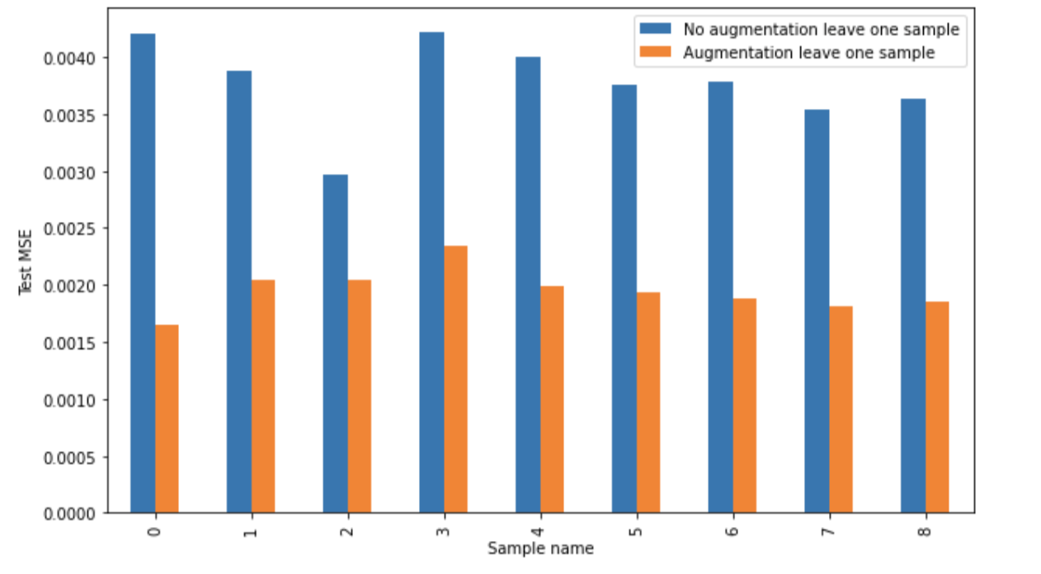
Data Augmentation significantly improves model performance
Test MSE comparisons between augmented vs non-augmented class composition prediction
Test MSE comparisons between augmented vs non-augmented absolute abundance prediction
Accuracy of sample origin = 100%
Accuracy of sample origin = 100%
Notes:
Talk about how we train (leave one out design)

Slide 10
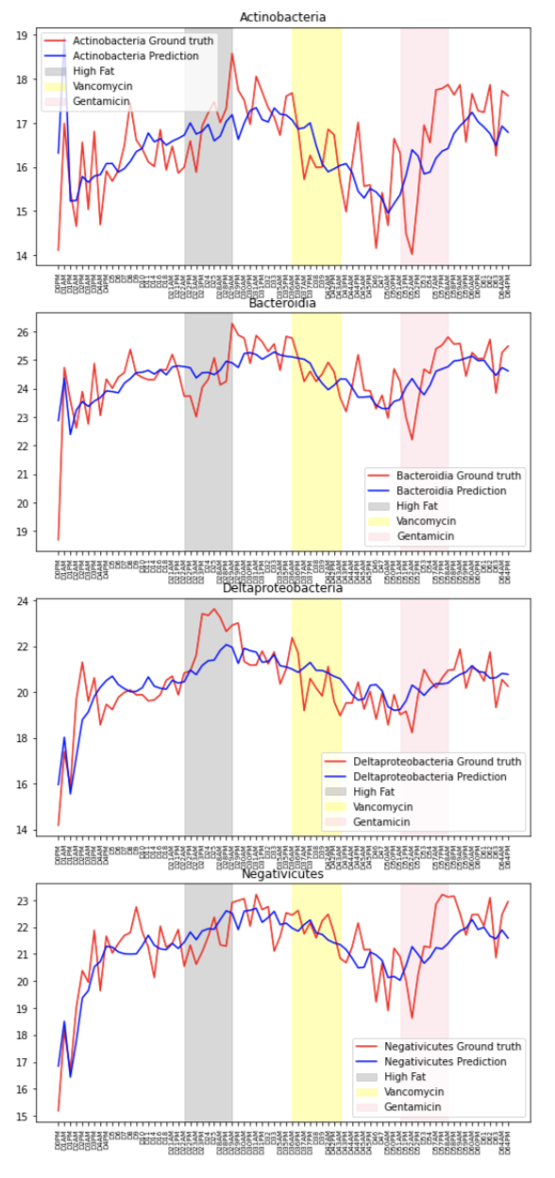
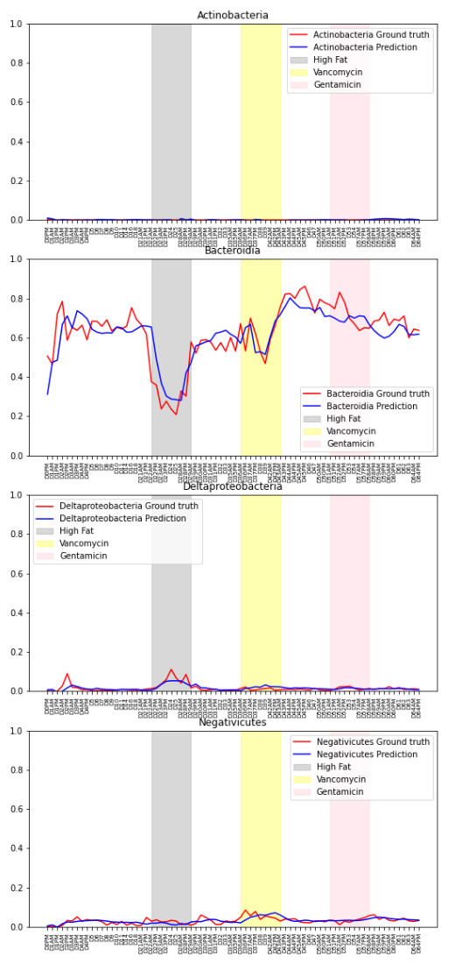
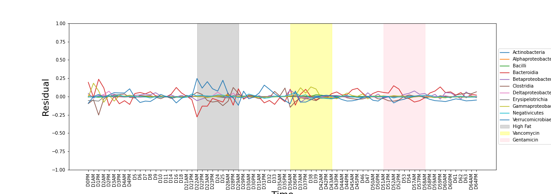
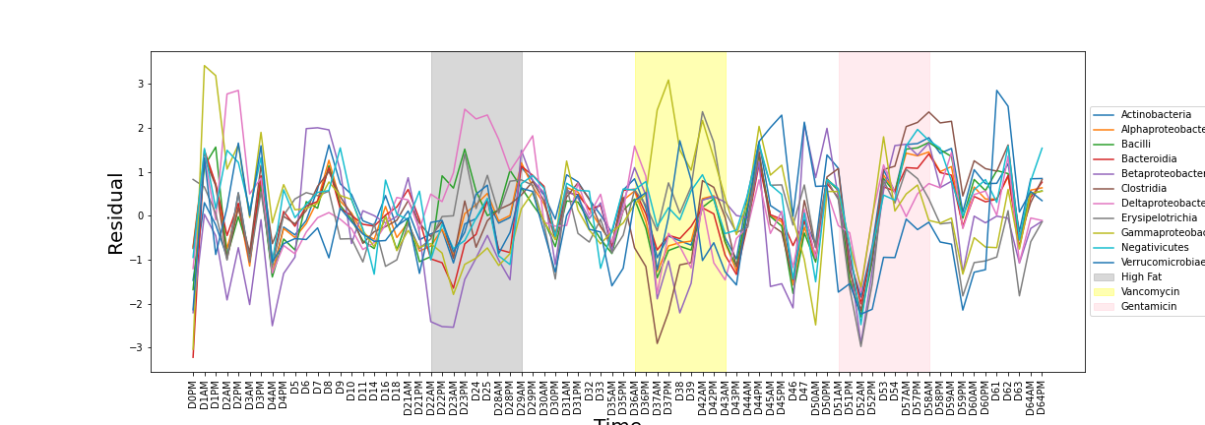
Prediction results for absolute and relative abundance
Absolute abundance
Relative abundance
Notes:
Able to capture overall trend
Absolute abundance predicted on [0,1] scale and plotted by back transformed log scale thus introducing source of noise
Reslatie abundance prediction can be more robust as residuals are bounded within -0.25 to 0.25

Slide 11
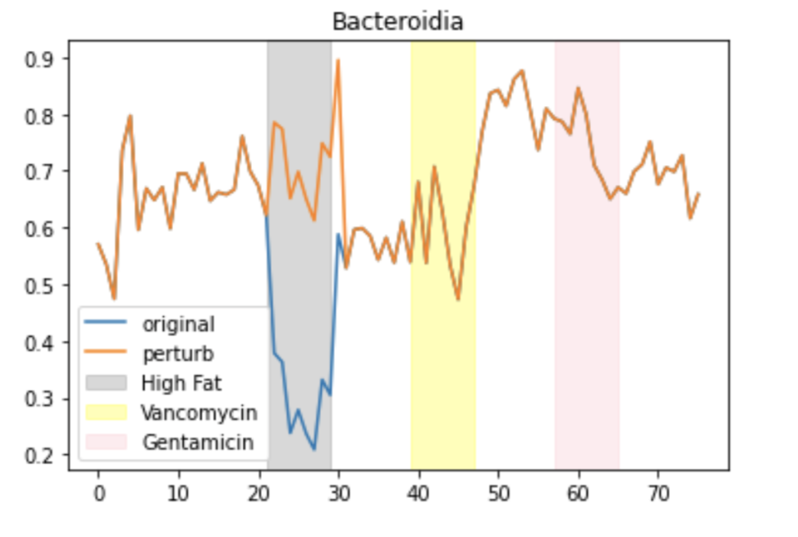
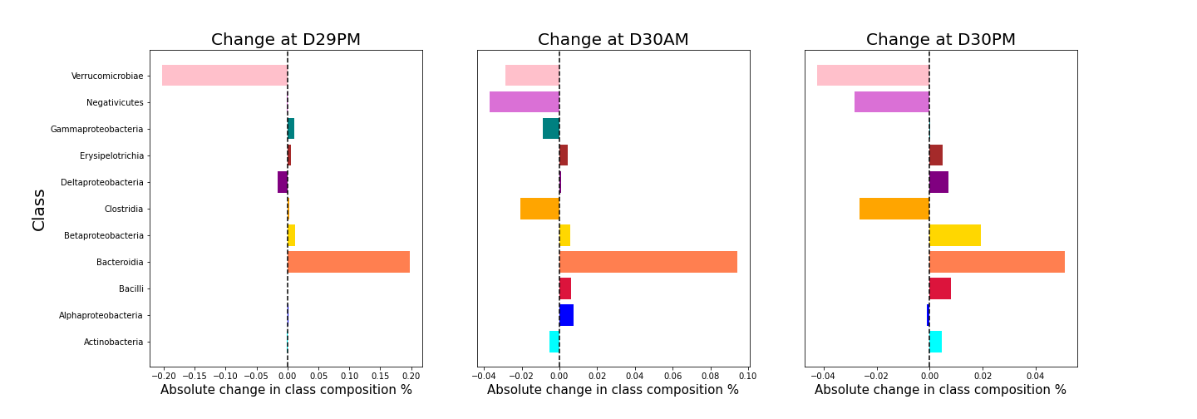
Model application: In-silico Perturbation
Trained Multi-head prediction model for relative abundance and absolute abundance
Perturn period over the course of treatment
Predicted changes at the immediate three time points after treatment
Perturb level of abundance at a chosen class over the course of treatment period
Absolute and relative change to measure predicted direction and magnitude of predicted change to ground truths

Slide 12
Conclusion and future direction
Strengths
Future directions
Multi-head model can accurately categorize sample origin and predict time series relative abundance.
Model structure is useful for in-silico experiments to learn species relationships
This model structure can be also extended to model other levels of taxonomy relationships. Eg. Species, Order, Family etc.
A comprehensive profiling of all possible combinations of changes in bacteria class and time intervals and examine their impacts on other species
Implement soft cut-off for variable selection by using auto-encoder based techniques to choose most representative latent variables
Limitations
Model on one taxonomy level ignores intra class variability
Absolute abundance prediction was not able to capture all the nuance changes across time points

Slide 13
Extra

Slide 14
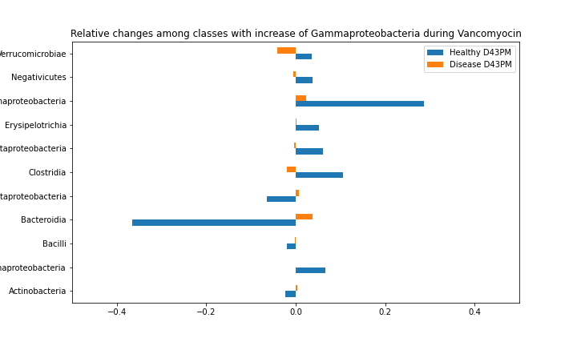
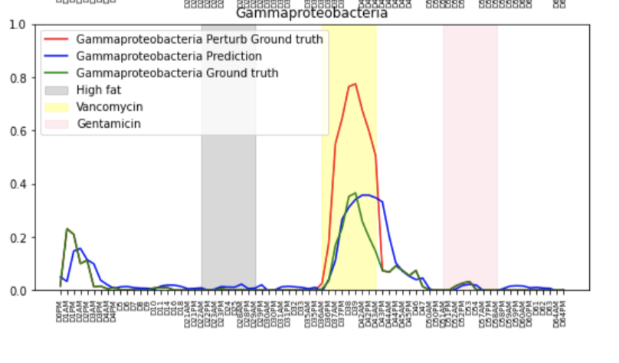
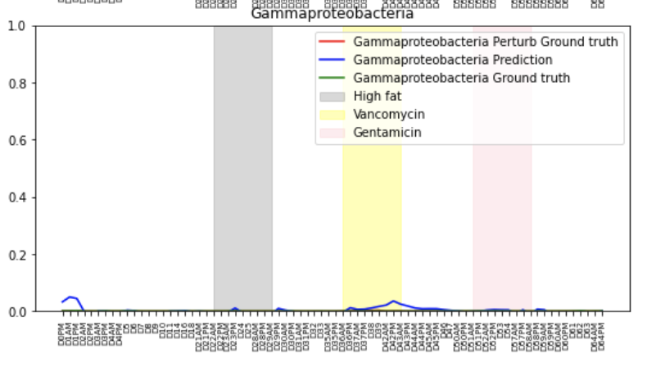
Gammaproteobacteria perturbation has higher impact on the healthy group than on the disease group
Healthy Donor sample
Ulcerative colitis donor sample
Healthy Donor sample has higher level changes
Notes:
An example where healthy and disease donor results diverge

Slide 15
Bacteroidia and Verrucomicrobia show antagonistic relationships for both healthy and disease donors
Increase levels of Bacteroidia class by 50% over the course of high fat diet treatment
Perturn period over the course of treatment
Predicted changes at the immediate three time points after treatment
Verrucomicrobia has the highest magnitude of change in relative abundance opposite to Bacteroidia
Similar effects are seen in both healthy and ulcerative colitis donors

Slide 16
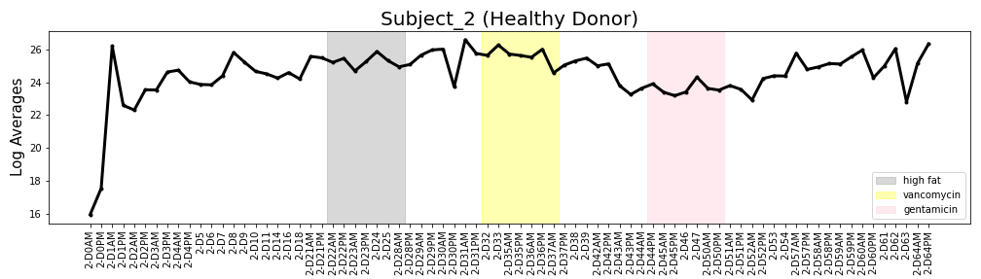
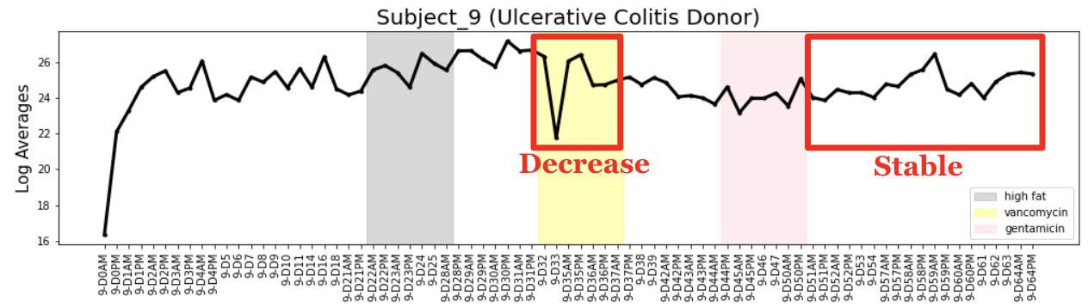
Total Abundance for Entire Microbiome across Time Uncovers Different Trends
Stable
Increase

Slide 17
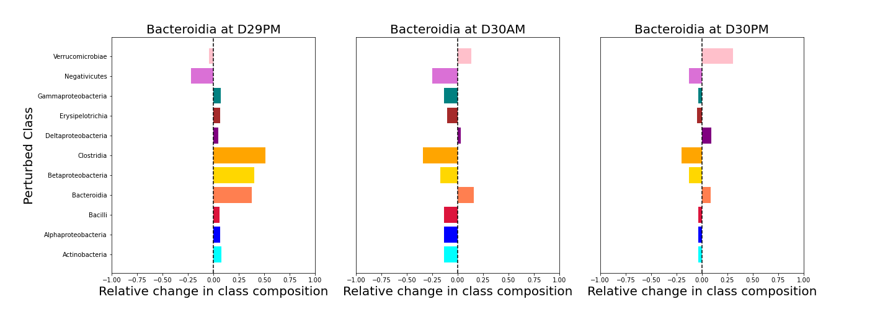
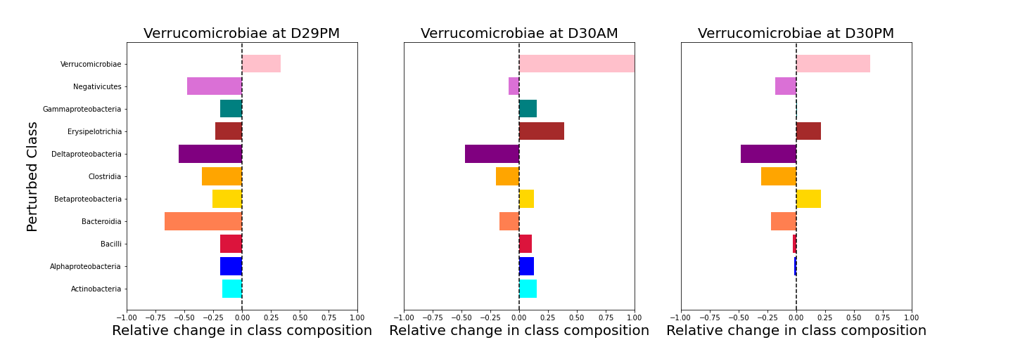
Bacteroidia and Verrucomicrobia show antagonistic relationships for both healthy and disease donors
Increase levels of every class by 50% over the course of high fat diet treatment
Record the predicted change of Bacteroidia and Verrucomicrobia at the immediate three time steps
Absolute and relative change to measure predicted direction and magnitude of predicted change to ground truths

Slide 18
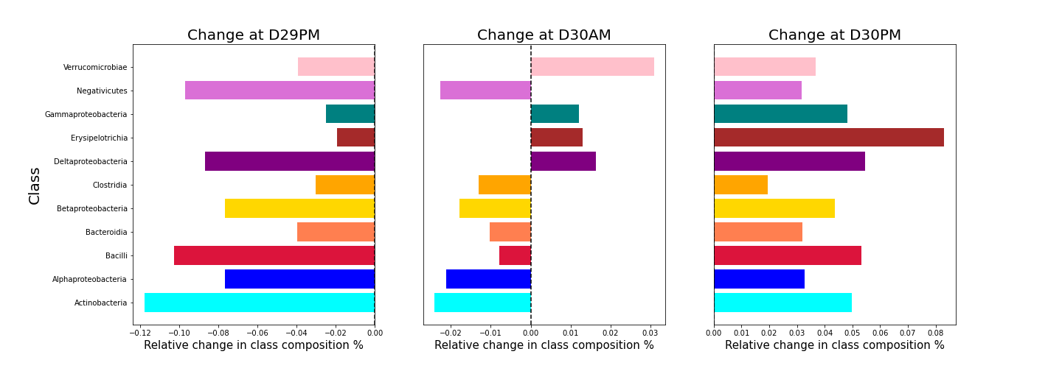
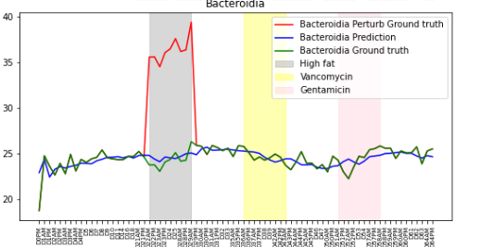
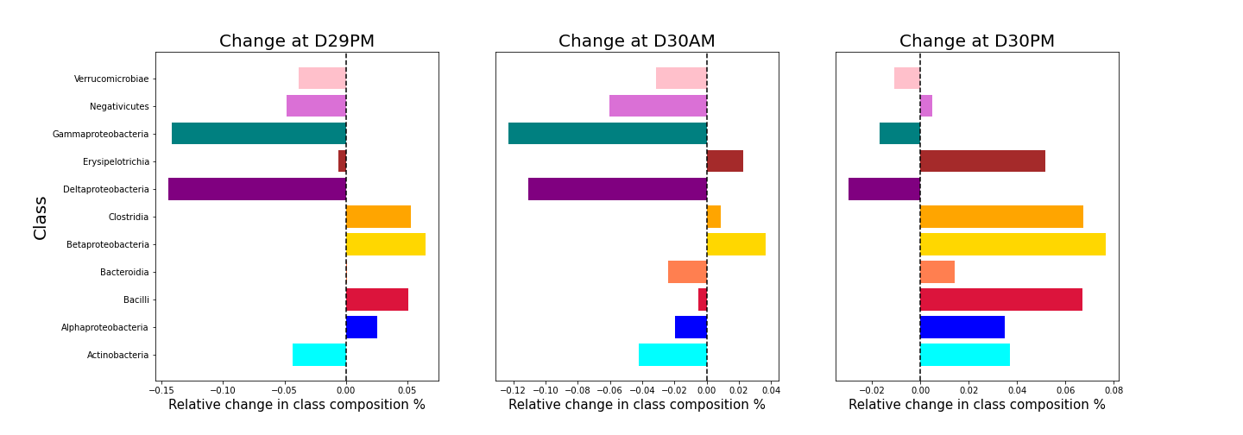
Absolute abundance prediction shows opposite reaction to the increase in bacteroidia in healthy and disease group
Healthy donors
Disease donors

Slide 19
Relative Abundances for Top Classes across Time Points
Notes:
Can be deleted

